Slide 1
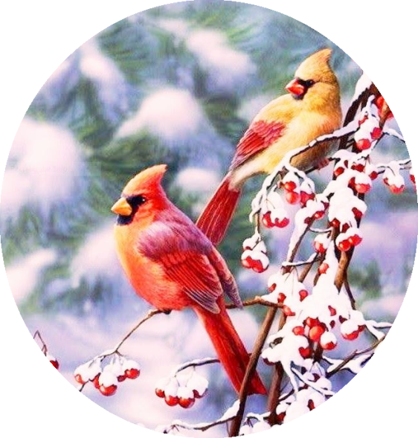
December January
Language & Literacy
Songs: “Months Of The Year”
“If All The Little Raindrops”
Selected Books: “Hibernation Station”
“Polar Bear Polar Bear”
“Brown Bear Brown Bear”
“Going On A Bear Hunt”
“The Mitten”
Home Link
Table Manners
Managing Emotions:
Expressing Feelings Into Words, Resolving Conflict
Hygiene: Practice Nose Wiping
Enjoy A Good Book Together
Collecting
Baking Soda & Cornstarch
Shaving Cream
All Sorts Of Items For Collaging
Projects
About Arctic Animals:
Where They Live, What They Eat, Where They Sleep
“The Mitten”: An Activity Sequencing Events
“Brown Bear Brown Bear” Paper Puppet
Working On Winter Gifts
Shaving Cream And Cars
Dramatic Play: Bakery Shop
Fishing Game: Name Recognition
Ice Painting
Center Focus
Fine Motor: Lacing Mittens
Gross Motor: Balancing - Bean Bag Boogie
Science: Salt, Ice And Water
Ice Catchers – Melting Predictions
Art: Pine Needle Wreaths
Block Ice Art Sculptures
Math: Counting Snowballs
Snowman Number Roll Game
Sensory: Making Snow
Painting On Ice
Snow And Arctic Animals
Teachers
Ms. Cindy
Ms. Kat

