Slide 1
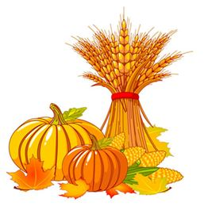
November
Language & Literacy
Song: “ Autumn Leaves Are Falling Down”
Selected Books:
“Eating The Alphabet”
“When Autumn Comes”
“Ox-Cart Man”
“Good Morning Owl”
“The Grumpy Morning”
Home Link
Help With Hand Washing And Toiletry
Work On Table Manners
Practice Putting On Shoes And Nose Blowing
Share A Good Story
Collecting
Flour And Cornstarch
Assorted Gourds
All Sorts Of Collage Items
Yarn
Center Focus
Fine Motor: Using Chubby Crayons For Grasping, Drawing And Tracing
Gross Motor: Bean Bag Balancing, Music And Movement
Science: Experimenting With Magnets.
Art: Exploring Different Mediums, Painting With Feathers, Salt, Crayon Resist
Sensory: Pumpkin Fluff And Salt Dough Prints
Math: Sorting And Counting Nature Items
Color recognition
Painting
Project
Outdoor Obstacle Course
Owl Dots-Dot Markers
Feather Painting
Stained Glass Leaves
Learning About Healthy Foods
Fruit And Vegetable Sorting Game
Pumpkin Letter Matching
I Spy Nature Trail Walk
Teacher
Ms. Cindy

