Slide 1
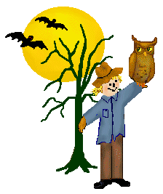
October
Language & Literacy
Song: “The Old Grey Cat”
“Jackolantern”
Selected Books:
“The Legend Of Spookley”
“When Autumn Comes”
“Five Little Pumpkins”
Home Link
Help At Home With Bathroom Hygiene
Work On Table Manners
Practice Dressing And Putting On Shoes
Cuddle Up And Read With Your Child
Collecting
Flour And Cornstarch
Assorted Gourds And Pumpkins
Colored Masking Tape
Yarn
Center Focus
Fine Motor: Paper Clipping Shapes
Stringing Beads On Fall Trees
Gross Motor: Freeze Dance
Sensory Tub: Fall Items and
Plastic Insects
Art: Painting With Shaving Cream
Math: Sorting Shapes And Colors
Science: Chemical Reactions To Apples
Our Four Seasons/Weather Changes
Different Clothing For
Different Seasons
Color recognition
Painting
Project
Making Ooblick
Foil Paintings
Leaf Rubbings
Nature Walk / Collecting Nature Items
Sorting Fall Leaves And Nature Items By Type, Size And Color
Snipping/Cutting Spider Braceletts
Marble Roll Spider Webs
Lacing Colored Shapes
Mixing Colors
Teacher
Ms. Cindy

